Slide 1
Pizza Sales Performance Report (1-Year Analysis)
A Data-Driven Review of Revenue, Customer Behavior & Product Performance
Presented by
Ademola Abraham Data Analyst
Date
March 2026

Slide 2
BUSINESS PROBLEM
The business currently lacks clear visibility into its sales performance and customer purchasing patterns.
Despite having a full year of transaction data, key questions remain unanswered:
Which products generate the most revenue?
What are the peak sales periods?
How do customer preferences vary by size and category?
Which products or categories underperform?
This limits the company’s ability to make informed decisions on pricing, promotions and inventory planning.

Slide 3
DATASET OVERVIEW
The dataset contains one year of pizza sales transactions, capturing detailed information about each order.
Key Fields:
Order ID: Unique identifier for each order
Date & Time: Timestamp of when the order was placed
Pizza Name: Specific product ordered
Category: Type of pizza (e.g., Classic, Veggie, Chicken, Supreme)
Size: Pizza size (S, M, L)
Quantity: Number of items ordered
Price: Unit price of each pizza
This dataset enables analysis of revenue trends, product performance and customer behavior.

Slide 4
DATA PREPARATION
Before performing the analysis, the dataset was reviewed to ensure its quality and readiness for exploration.
The dataset was found to be well-structured with no missing values, duplicates or inconsistencies.
Preparation Steps
Imported the dataset into Python using Jupyter Notebook
Inspected the dataset structure and variables
Verified data completeness and consistency
Adjusted data types of columns to appropriate formats for analysis
This preparation ensured the dataset was ready for accurate exploratory data analysis and visualization.

Slide 5
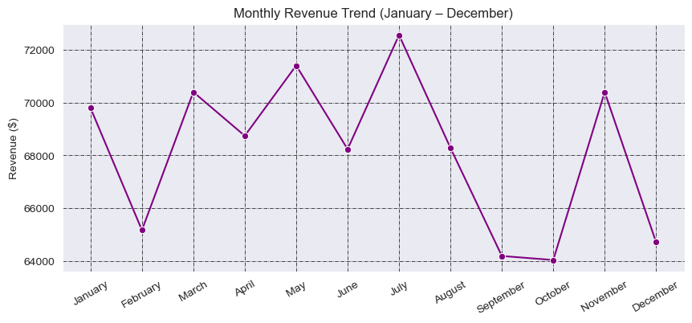
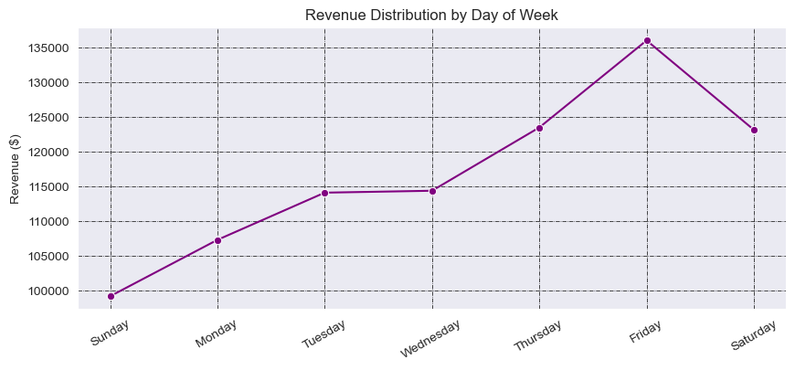
REVENUE PERFORMANCE ANALYSIS
Total Revenue: $817,860
Key Insights:
Revenue remained relatively stable throughout the year, with slight fluctuations across months
July recorded the highest monthly revenue, while October and September showed the lowest performance
Sales activity peaks towards mid-year, suggesting stronger customer demand during that period
Fridays generate the highest revenue, followed closely by Saturdays and Thursdays
Sundays produce the lowest revenue, indicating reduced customer activity
Revenue is strongly influenced by weekly customer behavior, with end-of-week periods driving the majority of sales.

Slide 6
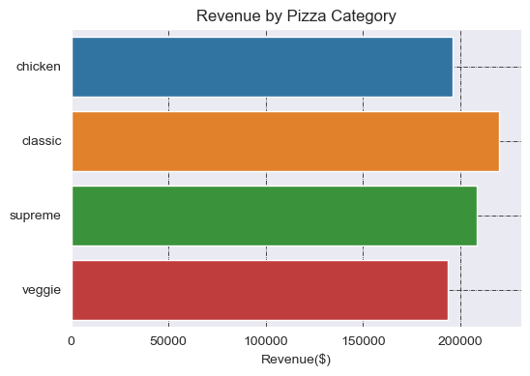
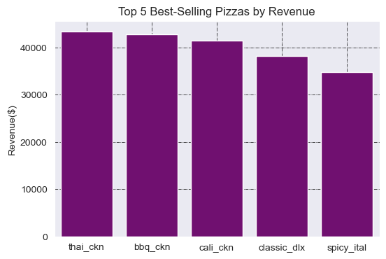
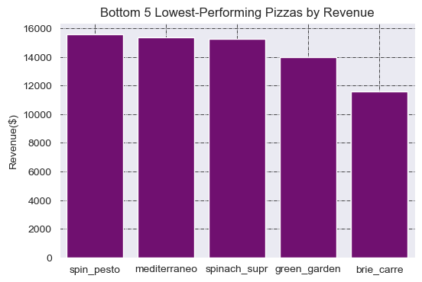
PRODUCT PERFORMANCE INSIGHTS
Key Insights:
Classic pizzas generate the highest revenue ($220K), making them the strongest performing category
Supreme and Chicken categories follow closely, showing balanced demand across premium options
Veggie pizzas contribute the least revenue, indicating lower customer preference
Top-performing pizzas are led by Thai Chicken, BBQ Chicken, and California Chicken, showing strong demand for chicken-based options
The best-selling items consistently combine bold flavors with familiar ingredients
Brie Carre, Green Garden, and Spinach Supreme are the lowest-performing pizzas
These products contribute minimal revenue and may require review or repositioning
A small group of high-performing pizzas drives a significant portion of total revenue, while several products underperform and may not justify their menu presence.

Slide 7
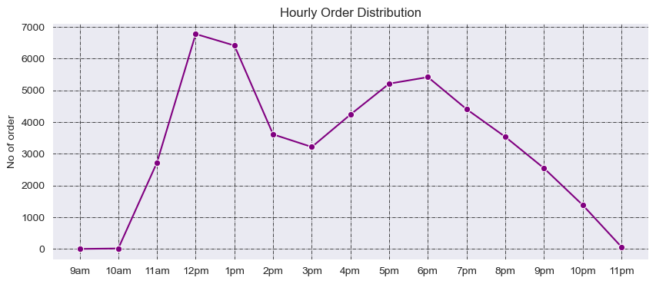
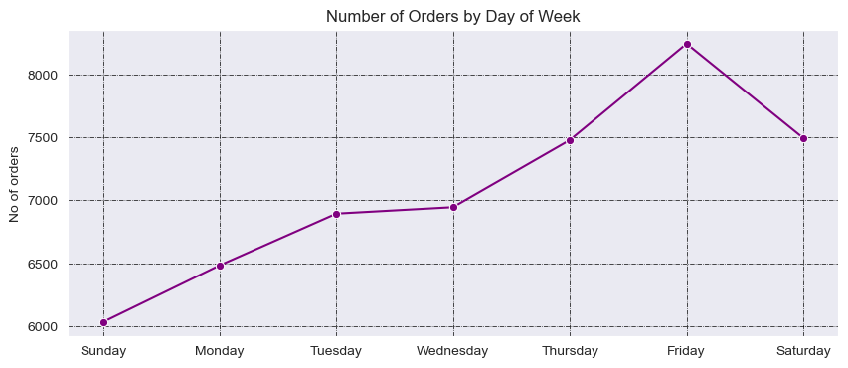
CUSTOMER PURCHASE BEHAVIOR
Average Order Value: $16.50
Key Insights:
Fridays record the highest number of orders, followed by Saturdays and Thursdays
Sundays have the lowest order volume, indicating weaker customer activity
Customer activity peaks between 12 PM and 1 PM, making lunchtime the busiest period
A second surge occurs in the evening (5 PM – 7 PM), showing strong dinner demand
Orders drop significantly after 9 PM, with minimal activity late at night
The average order value of $16.50 suggests moderate spending per transaction
This indicates potential opportunities to increase revenue through upselling or combo offers
Customer demand is highly time-driven, with peak activity concentrated around lunch and evening hours, especially towards the end of the week.

Slide 8
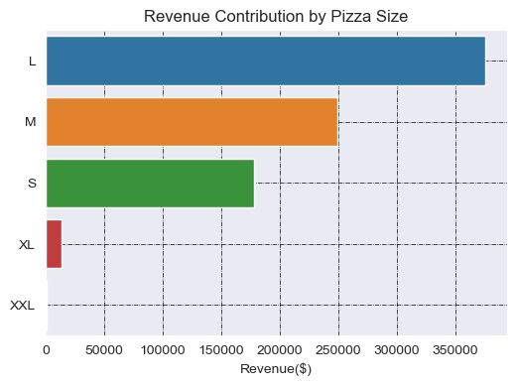
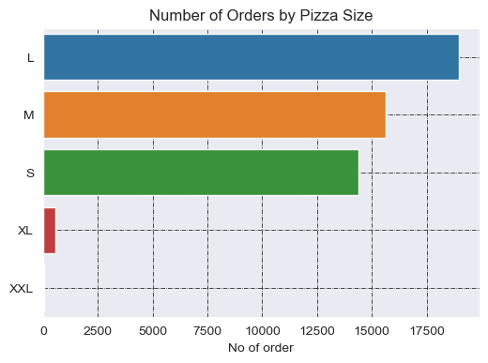
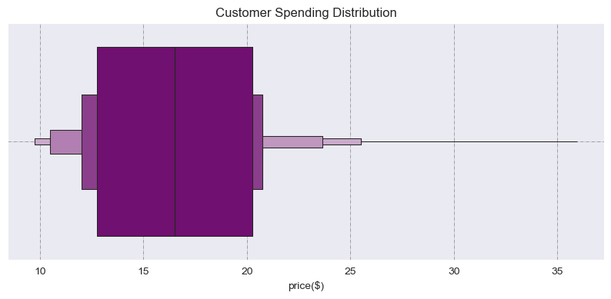
SIZE-BASED SALES ANALYSIS
Key Insights:
Large (L) pizzas dominate both in order volume and revenue, making them the primary driver of sales
Medium (M) and Small (S) sizes follow, with noticeably lower performance
Large pizzas generate the highest revenue ($375K), contributing nearly half of total sales
Medium and Small sizes contribute significantly less, showing a clear customer preference for larger portions
XL and XXL sizes have extremely low demand, with minimal contribution to overall revenue
These sizes may not be popular with customers or may not be priced attractively
Customers clearly prefer larger pizzas, and pricing supports this behavior, making large sizes the most valuable segment for revenue growth.

Slide 9
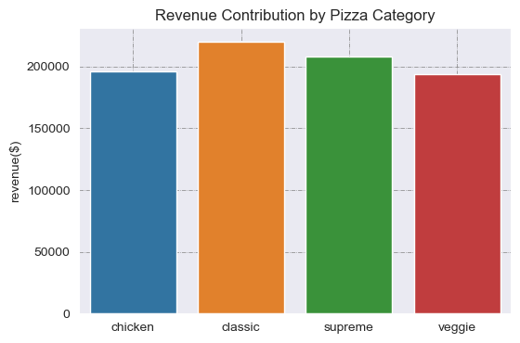
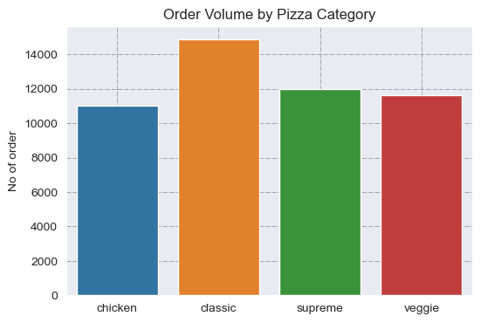
CATEGORY CONTRIBUTION TO REVENUE
Key Insights:
Classic pizzas generate the highest revenue ($220K), making them the most profitable category
Supreme and Chicken categories follow closely, contributing strong and consistent revenue
Veggie pizzas generate the lowest revenue, indicating weaker overall performance
Classic category also leads in total orders, confirming its strong popularity among customers
Other categories (Supreme, Veggie, Chicken) show relatively similar order volumes
The comparison shows that higher popularity generally translates to higher revenue, especially for Classic pizzas
However, some categories generate strong revenue despite slightly lower order volume, suggesting higher pricing or premium positioning
Classic pizzas dominate both in popularity and revenue, while other categories present opportunities for pricing, promotion, or repositioning strategies.

Slide 10
KEY BUSINESS INSIGHTS
The business generated $817,860 in total revenue, with stable performance across the year
Revenue is driven by end-of-week demand, with Fridays and Saturdays showing the highest activity
Customer behavior peaks during lunch (12–1 PM) and evening hours (5–7 PM)
Large-sized pizzas dominate both demand and revenue, contributing the largest share of sales
Classic category leads in both popularity and revenue, making it the core product segment
A small group of top-performing pizzas drives a significant portion of total revenue
Several products and sizes (e.g., XXL) show very low demand and minimal revenue contribution
Sales performance is driven by a combination of timing, product preference and portion size.

Slide 11
BUSINESS RECOMMENDATIONS
1. Focus on High-Performing Products
Promote top-selling pizzas (e.g. Thai Chicken, BBQ Chicken)
Feature them in ads, bundles and homepage displays
2. Optimize Low-Performing Items
Review or remove underperforming pizzas (e.g. Brie Carre)
Reposition with new pricing or marketing if necessary
3. Leverage Peak Sales Periods
Run promotions on Fridays and weekends to maximize revenue
Introduce lunch deals (12–2 PM) and dinner bundles (5–7 PM)
4. Increase Average Order Value
Introduce combo offers (pizza + drink + side)
Offer upsizing incentives (e.g. “Upgrade to Large for a small extra cost”)
5. Focus on Large Size Strategy
Promote Large pizzas as the “best value” option
Bundle large sizes for group or family deals
6. Reevaluate XL & XXL Sizes
Consider removing or repricing due to low demand
Alternatively, reposition them for special occasions or group orders
Focusing on high-demand products, peak periods and value-driven pricing can significantly improve revenue and efficiency.

Slide 12
THANK YOU
Thank you for your time and attention
Presented by
Ademola Abraham Data Analyst
Open to questions and further discussion

